Slide 1
Break The Echo Chamber:
Improvement of Video Recommendation System Based on GNN
By Group 4: Peng Wang, Yantao Mei, Yu Cheng
Notes:
Yantao

Slide 2
Outline
Introduction
Method
Result & Validation
Conclusion
The process of project

Slide 3
Introduction

Slide 4
Echo Chamber Effect
Notes:
So here we are going to explain what is the echo chamber effect

Slide 5
Echo Chamber Effect
Echo Chamber
In news media and social media, an echo chamber is an environment or ecosystem in which participants encounter beliefs that amplify or reinforce their preexisting beliefs by communication and repetition inside a closed system and insulated from rebuttal. (Wikipedia)
This is different to information cocoon
As the public's attention is solely drawn to information of personal interest, they ultimately confine themselves within a cocoon resembling that of a silkworm chrysalis.
Notes:
讲清楚echo chamber 和

Slide 6
Echo chamber effect show in Markov chain
0.3
0.7
0.4
0.3
0.3
0.8
0.2

Slide 7
How to break the echo chamber?
Increase the variety of the sources of information:
Increase the media you are using (Digital media, TV, newspaper)
Use multiple apps (Bilibili/Youtube, Weibo/Zhihu, Ins/Facebook)
Increase the variety of subjects or angles of information. (Follow different Youtuber in the same area or try to attempt new video themes)

Slide 8
Method
Notes:
Gloria

Slide 9
Present Systems

Slide 10
Present system
YouTube algorithm
1. Filtering and vectorization of features
2. Fully connected ReLU neural networks
3. Objective function ranking
TikTok algorithm
1. Consideration of reposts, likes, and shares
2. Importance of video tags
Limitations of Current Algorithms
A. Focus on promoting popular content
B. Lack of emphasis on breaking the echo chamber
C. Need for a more diverse range of recommendations

Slide 11
Proposed Method

Slide 12
Proposed Method
By using GNN and treating each video as a node the nodes belonging to the same or similar topic will be gathered together in the same range (or same quadrant).
Starting from one node (the video users are looking at), we can generate paths to the videos of the set topic/tags.
With this method, users can set their goal (target topic) and start from videos that they are watching now to the videos they want to give a try without sudden topic changes causing uncomfortableness.

Slide 13
Graph Neural Network
Notes:
Peng

Slide 14
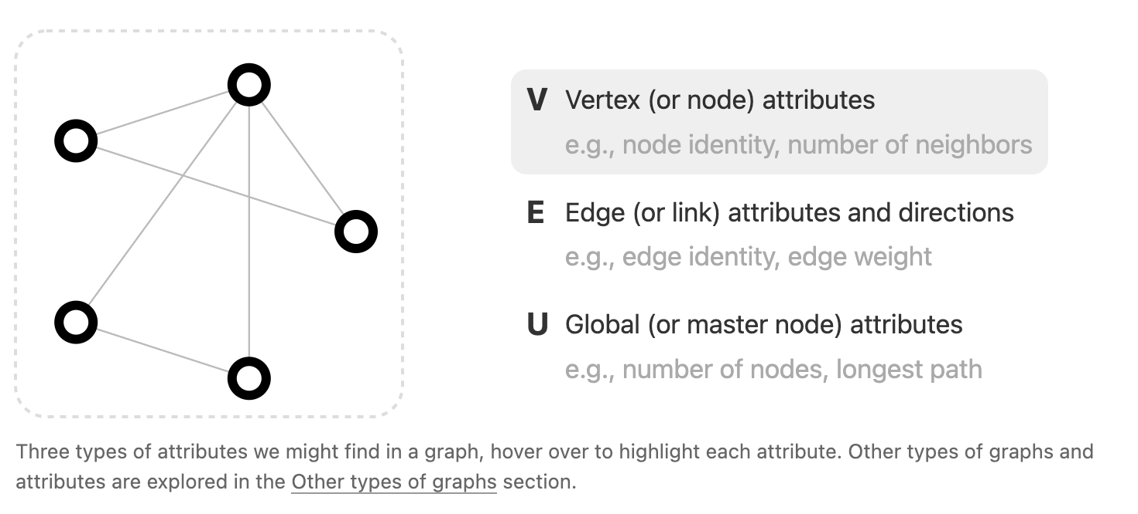
Graph

Slide 15
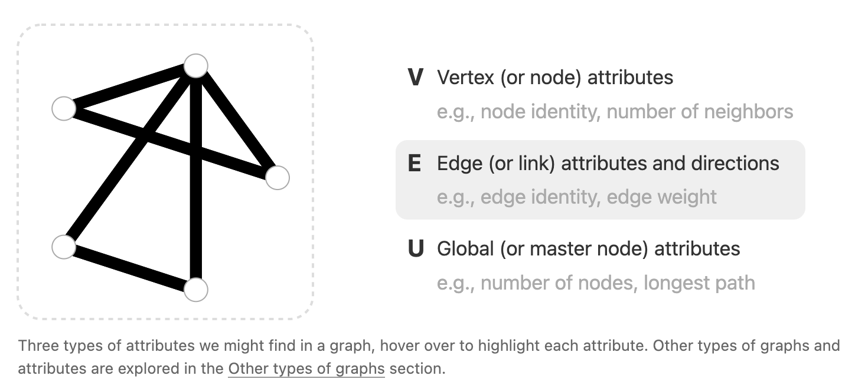
Graph

Slide 16
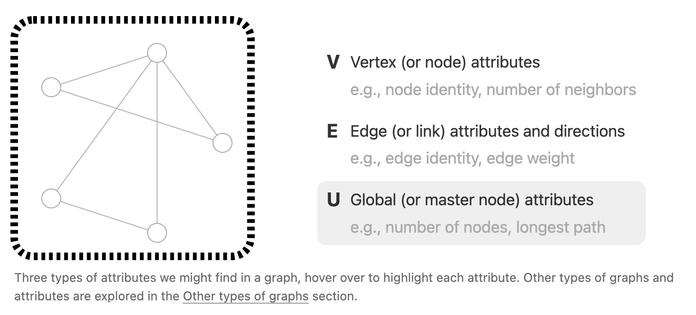
Graph

Slide 17
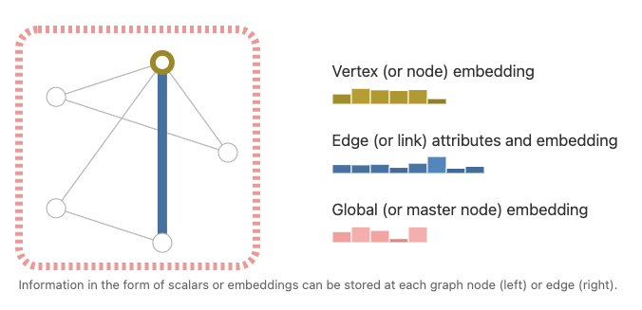
Graph

Slide 18
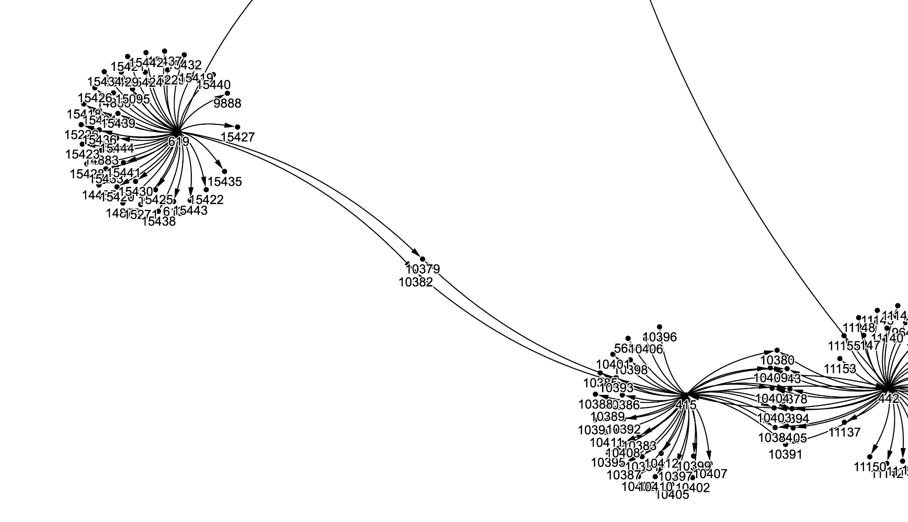
How we construct the Graph

Slide 19
Video Recommendation System 2.0
Notes:
Gloria:这个底下就是介绍我们总的system是怎么工作的

Slide 20
Process
Wait the user pick the next video
Then the next video will be the new node to generate new lists and after the loops we expect the users will achieve the goal set by themselves.
03
Get current node and the target range of videos (Based on Tag)
At the beginning, we will let the user decide which video to start with and which type of videos the user like to be end up with
01
02
Generate an recommendation list
According to our GNN, we generate some paths to the target range of videos and list them in the order of path length, from short to long.

Slide 21
Examples
Other videos that player meet HIM
HIM
Minecraft story
Anime about HIM
Self made Minecraft story anime
Minecraft Buildings
Other Minecraft videos
Videos of buildings made by Minecraft
Original anime
Video Game
Replica anime made by Minecraft
Another similar replica
Anime
Technology
The graphical card ads about game recording
Video Game (Minecraft)
Anime

Slide 22
Dataset
Notes:
Yantao: 底下包括你可以介绍distance之类的东西

Slide 23
How we get the data
We use the Bilibili API to scrape the videos related to the hottest 5 videos in March 2023 of 7 subtags under the “生活” channel (vlog, food, handwork, farm, etc.) According to API, we can get 40 videos attached to the video.
First attempt
We filter the videos and only scrape the top 40 video with the highest importance from the second layer. We scrape 4 layers of data before we find a huge mistake.(will be covered in result part)
Second attempt
We scrape all videos’ related video instead of scrape them with selectively. We get 3 layers with more than 35*40*40*40 (about 2.2 millions) videos.

Slide 24
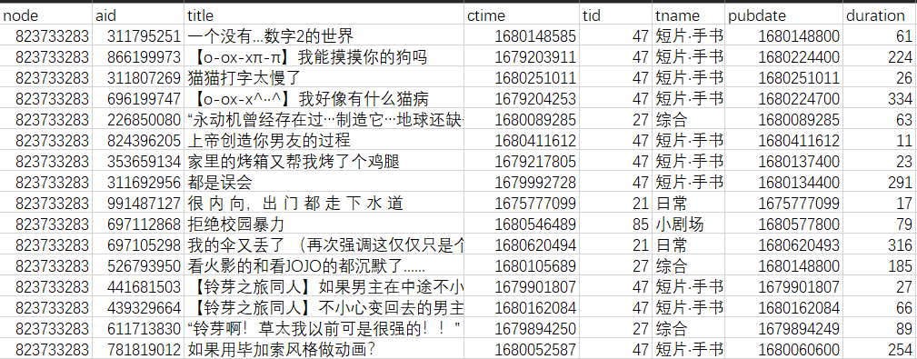
Dataset

Slide 25
Result & Validation

Slide 26
Performance Evaluation
Notes:
Gloria

Slide 27
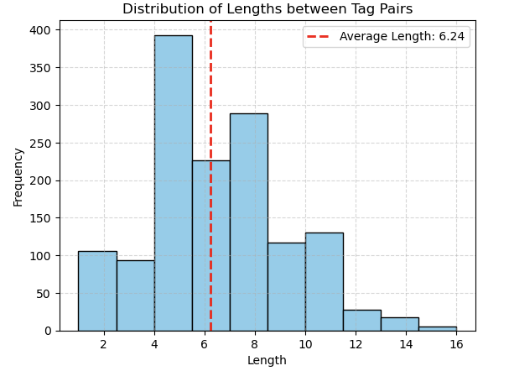
Performance expectation
Expectation of the average steps system cost to shift the topic
According to our calculation of the distance between tags (how many video we need to reach from one tag’s center node to another’s center node), we find the average distance is about 6.24 videos. That is to say, the system’s best performance will be shift the interest in 7 videos.

Slide 28
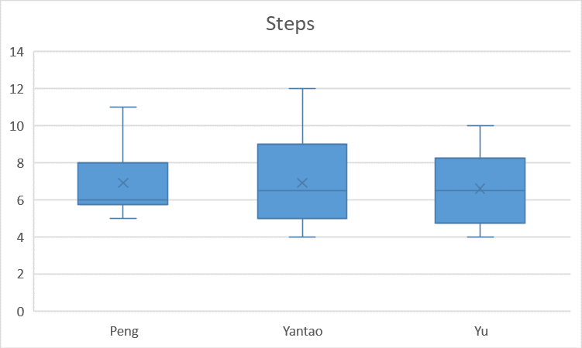
Evaluation
Testing by ourselves
To evaluate the system, we choose 10 sets of beginning videos and target tag randomly form the dataset and test how many step we used to shift our interests. Amoun the three of us, we can see the average step is about 7.

Slide 29
Demonstration
Notes:
WP

Slide 30



target_tag= 17, initial_video=30473

Slide 31
From Dataset
Notes:
Yantao

Slide 32
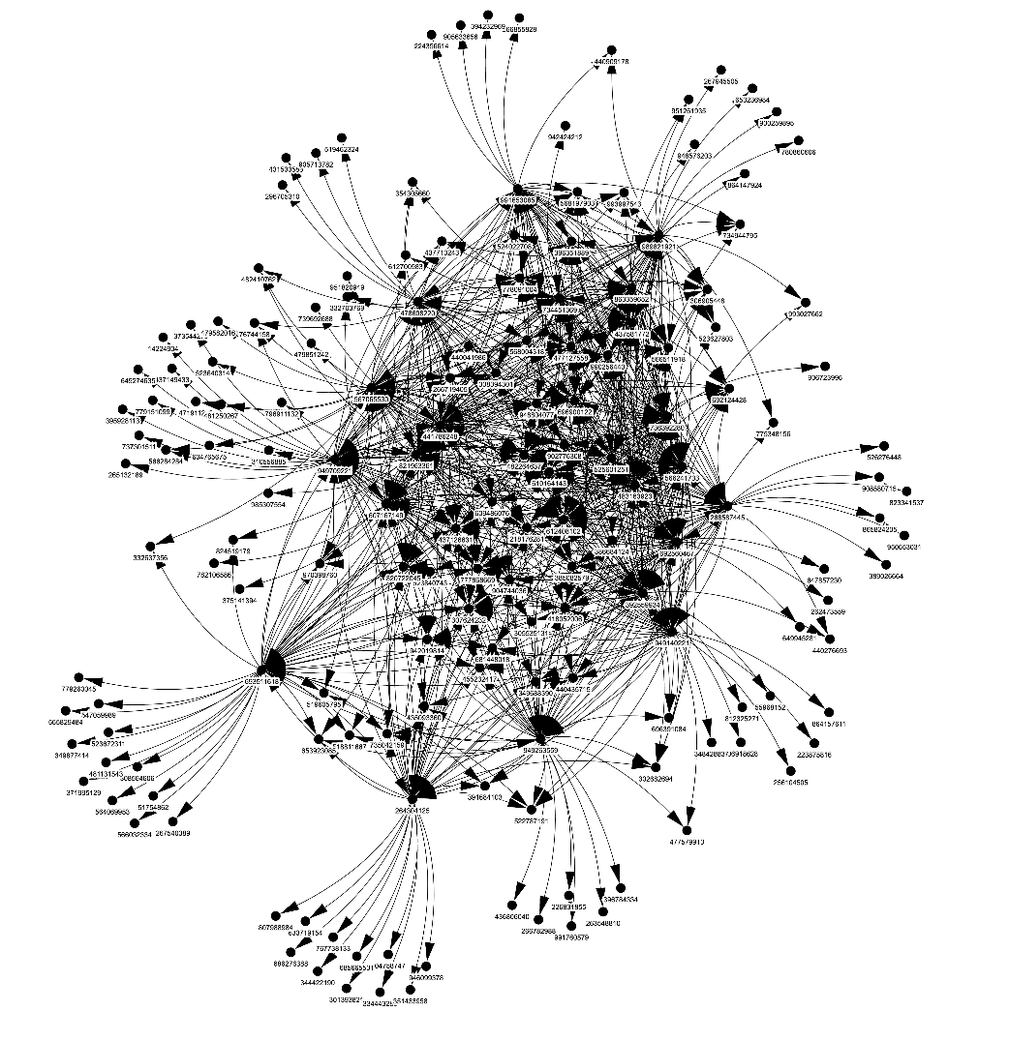
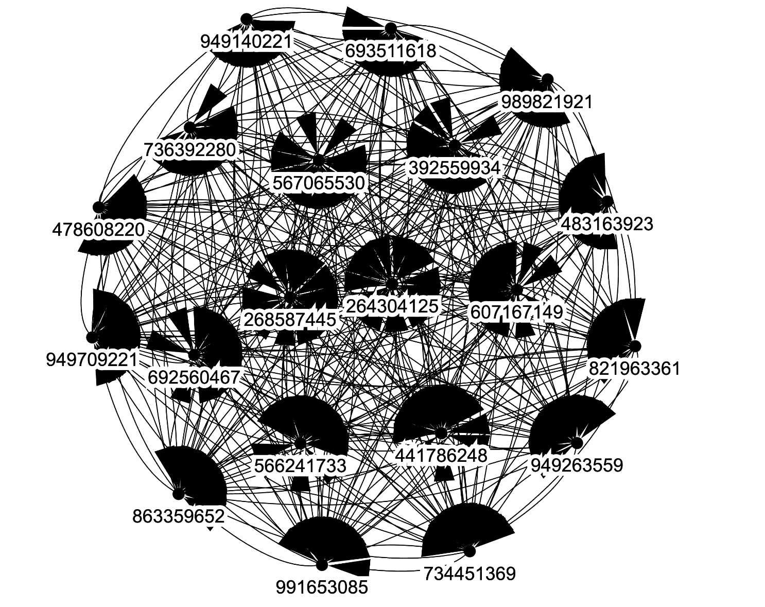
First Iteration
Fourth Iteration

Slide 33
Data structure with bias
During the data scraping process we observe
The videos related to one video may produced by same UP (uploader) with the similar tags and similar content.
By adding an filter while scraping, we reproduced the echo chamber effect in our dataset mistakely.
That is why we choose to scrape related videos for all nodes instead of filtering them while we scraping the data.

Slide 34
Conclusion
Notes:
Together

Slide 35
Conclusion
We emphasize the critical issue of information cocoons and echo chambers.
We propose a groundbreaking solution utilizing Graph Neural Networks (GNNs) to expand content diversity and overcome echo chambers.
During the evaluation process, we noticed that we also need GUI to make our system easy to use and other functions together with GNN to improve the system.
The ultimate aim is to create more effective and inclusive recommendation systems that promote open-mindedness, critical thinking, and to help users to open their horizon.

Slide 36
Thanks For Listening

Slide 37
Reference list
Covington, P., Adams, J., & Sargin, E. (2016, September). Deep neural networks for youtube recommendations. In Proceedings of the 10th ACM conference on recommender systems (pp. 191-198).
Davidson, J., Liebald, B., Liu, J., Nandy, P., Van Vleet, T., Gargi, U., ... & Sampath, D. (2010, September). The YouTube video recommendation system. In Proceedings of the fourth ACM conference on Recommender systems (pp. 293-296).
Goodrow, C. (2021, September 15). On YouTube's recommendation system. blog.youtube. Retrieved April 7, 2023, from https://blog.youtube/inside-youtube/on-youtubes-recommendation-system/
Klug, D., Qin, Y., Evans, M., & Kaufman, G. (2021, June). Trick and please. A mixed-method study on user assumptions about the TikTok algorithm. In 13th ACM Web Science Conference 2021 (pp. 84-92).
Sunstein, C. R. (2008). Infotopia: How many minds produce knowledge. Oxford University Press.
Wu, S., Sun, F., Zhang, W., Xie, X., & Cui, B. (2022). Graph neural networks in recommender systems: A survey. ACM Computing Surveys, 55(5), 1–37. https://doi.org/10.1145/3535101
Wu, Z., Pan, S., Chen, F., Long, G., Zhang, C., & Yu, P. S. (2021). A comprehensive survey on Graph Neural Networks. IEEE Transactions on Neural Networks and Learning Systems, 32(1), 4–24. https://doi.org/10.1109/tnnls.2020.2978386
Social Sister Yi. bilibili-API-collect. https://github.com/SocialSisterYi/bilibili-API-collect/tree/master

Slide 38
Q & A

